Slide 1
Application of AI

Slide 2
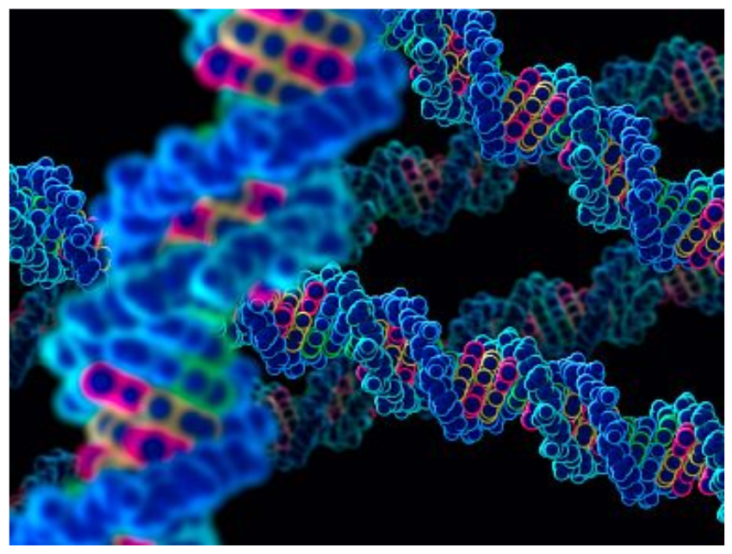
Human Genome

Slide 3

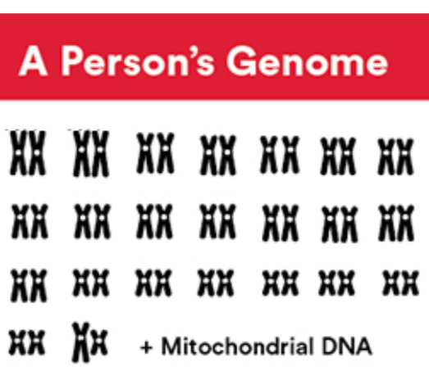

Slide 4
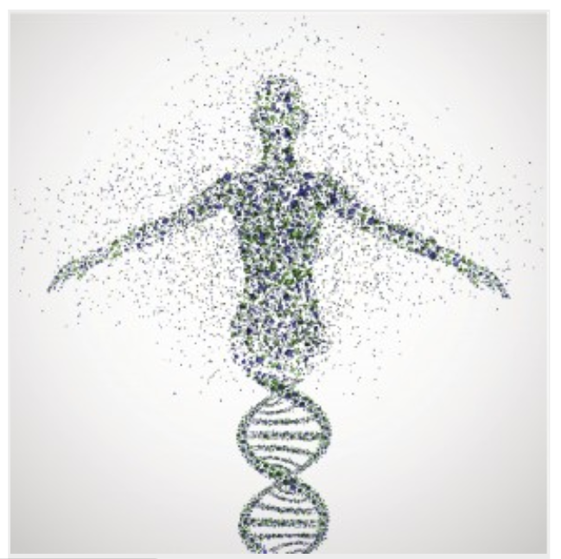

Slide 5
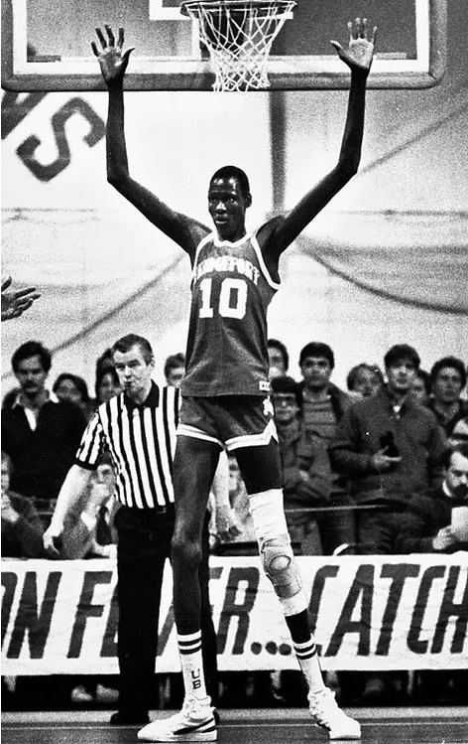

Slide 6
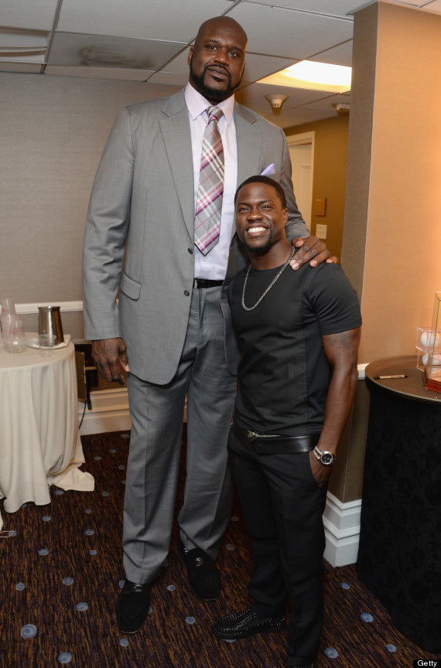

Slide 7
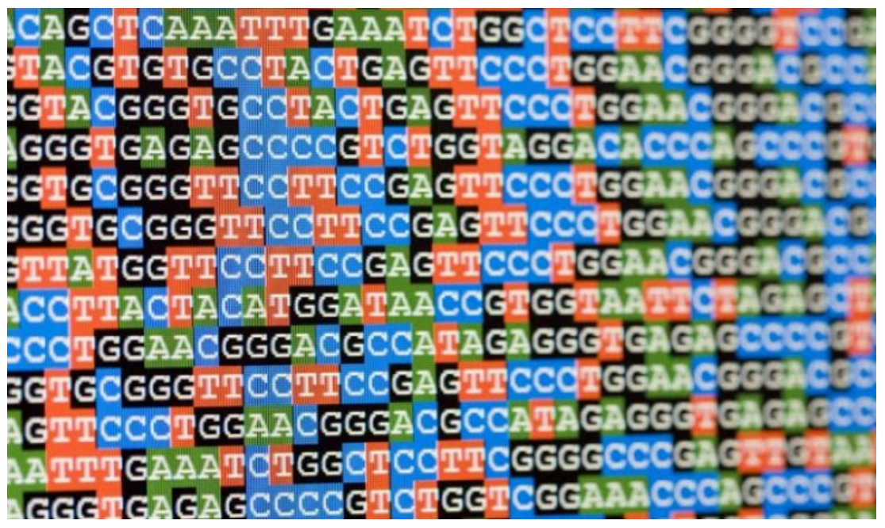

Slide 8
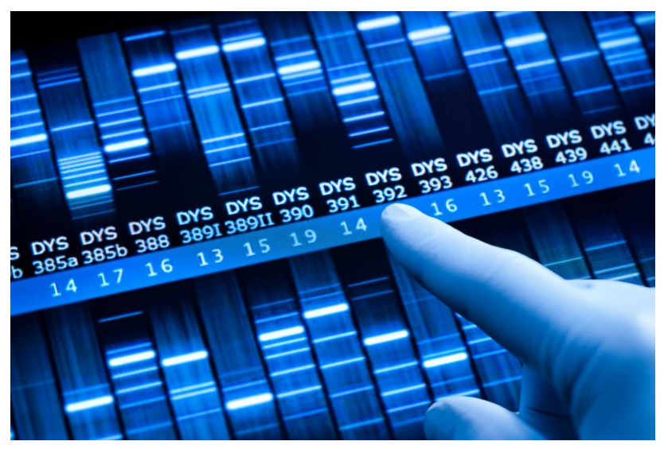

Slide 9
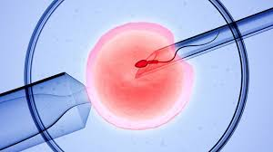
In Vitro Fertilization

Slide 10
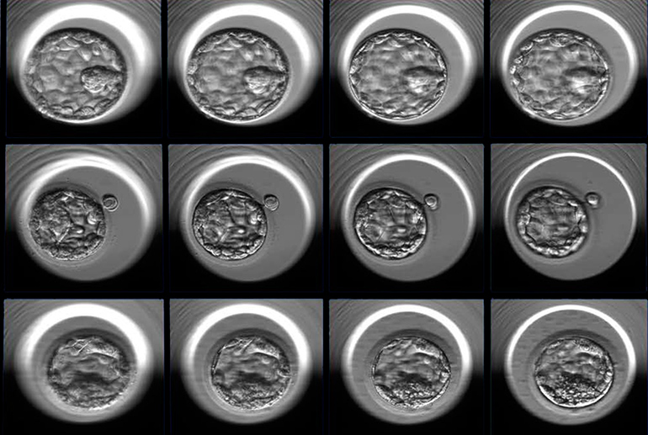
good
fair
poor

Slide 11
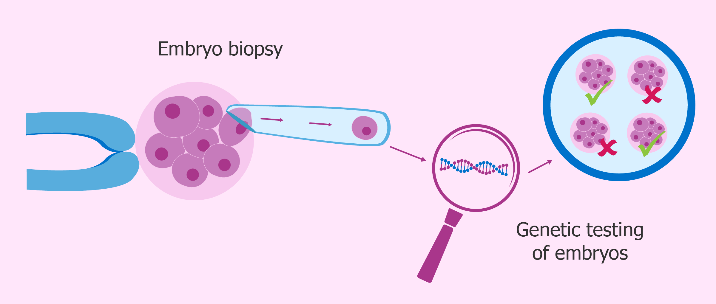

Slide 12
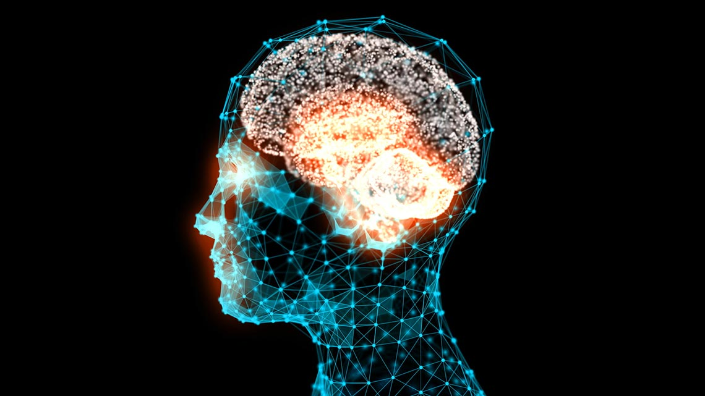

Slide 13
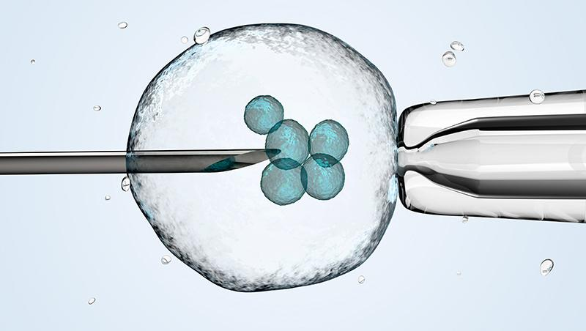

Slide 14
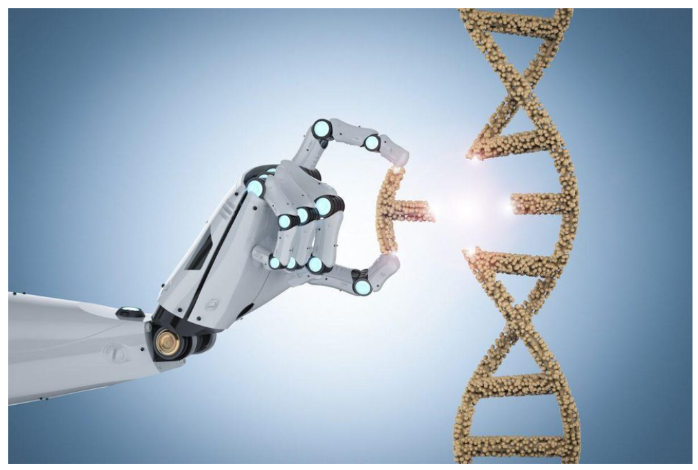
Gene Editing

Slide 15


Slide 17
How to choose an AI project

Slide 18
How to choose an AI project
What’s valuable to
you or your business
What AI can do

Slide 19
Feasible

Slide 20
Feasible
Is it a task that AI can do?

Slide 21
Feasible
Is it a task that AI can do?
Are you collecting the data?

Slide 22
Feasible
Is it a task that AI can do?
Are you collecting the data?
How much data will you need?

Slide 23
Valuable

Slide 24
Valuable
What are the main pain points in your organization?

Slide 25
Valuable
What are the main pain points in your organization?
What are the main drivers of value?

Slide 26
Valuable
What are the main pain points in your organization?
What are the main drivers of value?
Think about automating tasks.

Slide 27
Automated ML

Slide 28




Slide 29
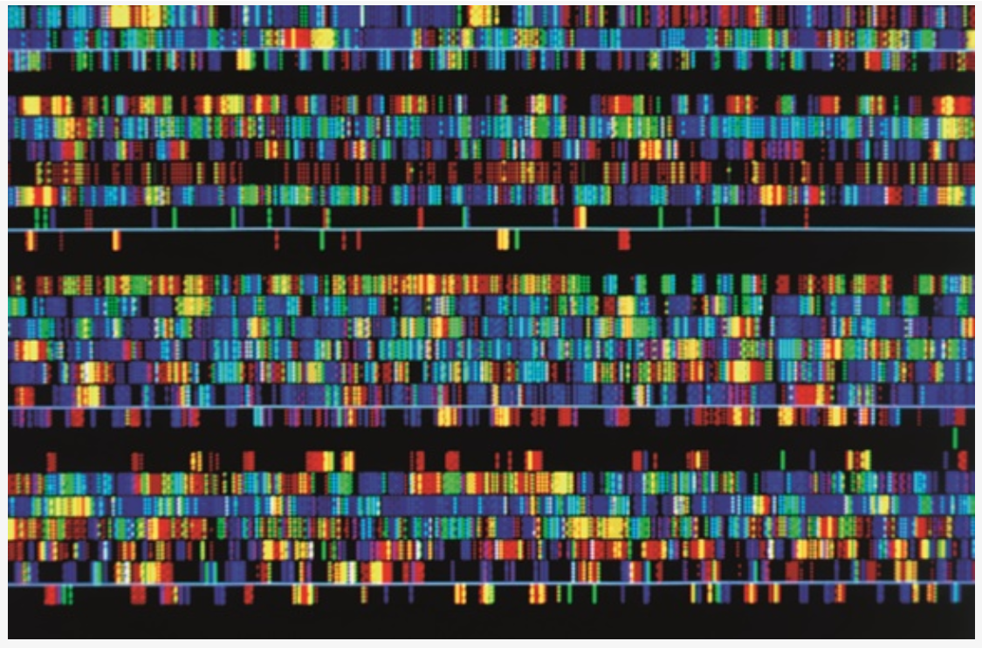

Slide 30


Slide 31


Slide 32
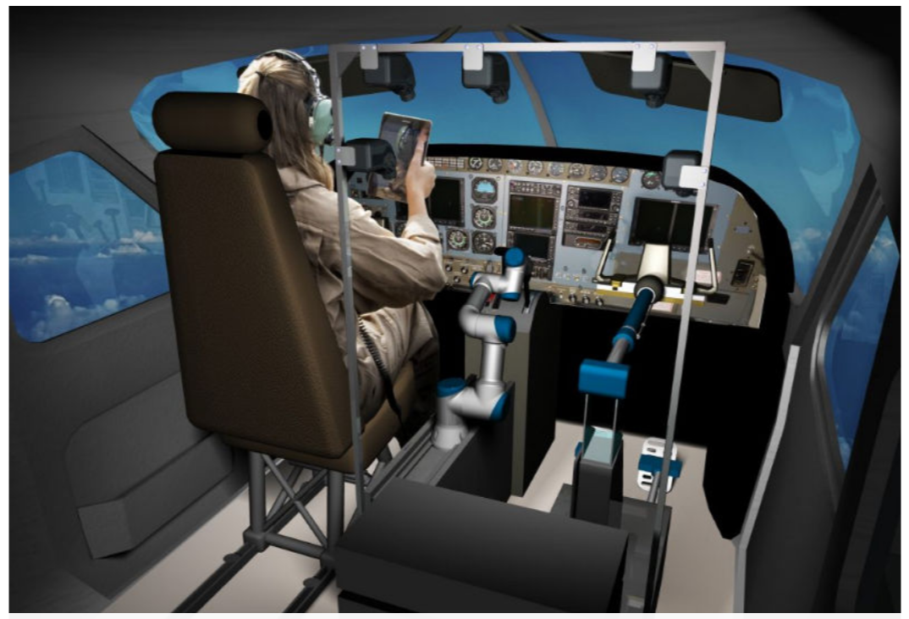

Slide 33
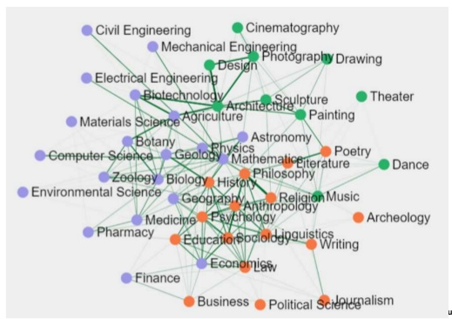

Slide 35
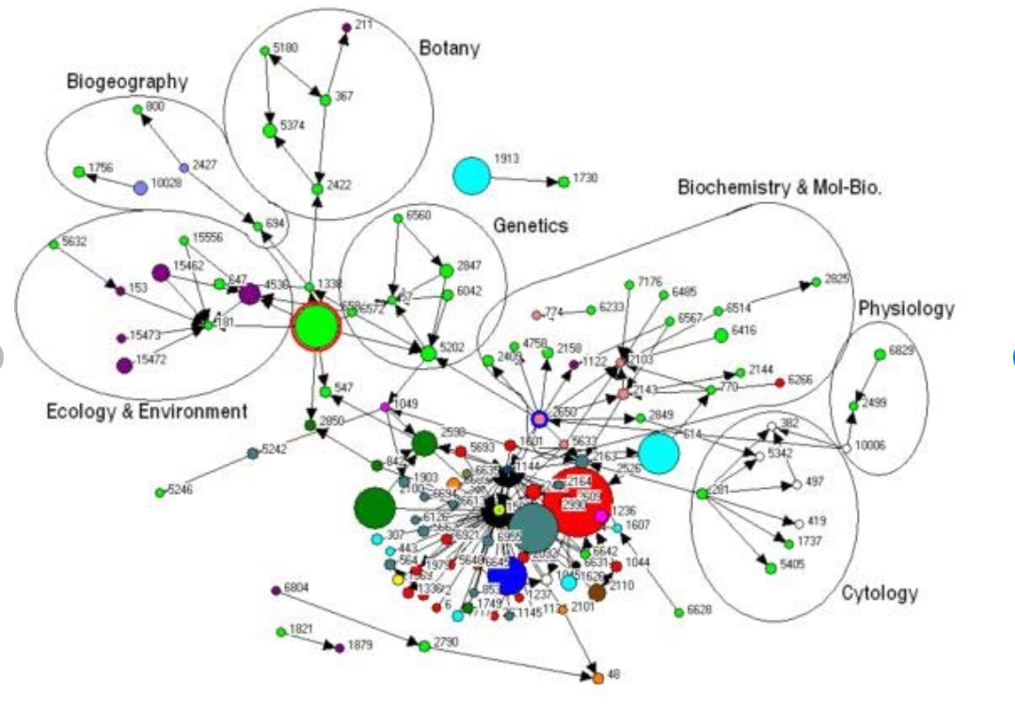
Interdisciplinary Network of Biology

Slide 36
